Slide 1
CS123: Lecture 1 Actuators and PD Control
2024
Notes:
For your first lab you will be learning to control the actuators we will be using. In today mini-lecture I will aim to introduce you to two concepts: 1) How these actuators work 2) The basic algorithms we will use when operating them

Slide 2
Learning Goals
How do the actuators produce force?
How is that force controlled algorithmically?
What technologies have enabled modern actuator design?

Slide 3
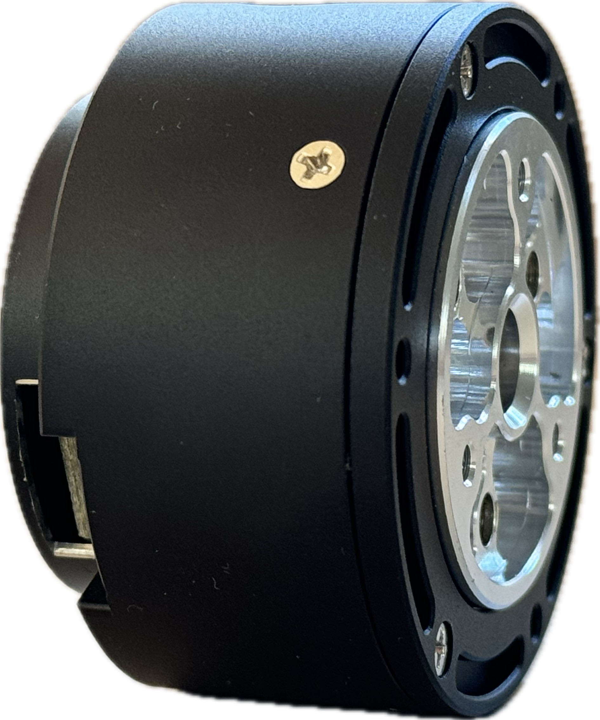
Actuator
Control Algorithms
Gearbox
Motor
Motor Controller
Notes:
The motor is technically just the part of the bottom.

Slide 4
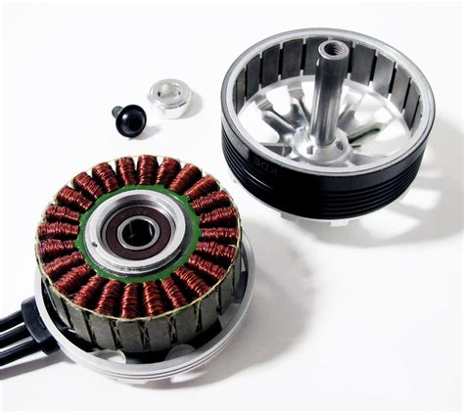
Actuator - Brushless Motor
Permanent Magnets
Electromagnets

Slide 5
Electromagnet
Permanent Magnets

Slide 6
Motor
N
Permanent Magnets
S
S
N
Electromagnet
Notes:
Note that these could all be electromagnets, but that creates a real challenge of how to get power to the outer part which is spinning in circles. In practice rare earth magnets offer a great alternative where they have a strong magnetic field and we don’t need to deliver power too them.
For the inner magnets we will see that it is important to change their magnetic field so they need to be electormagnets

Slide 7
N
N
S
S
S
N
N
S
Set common polarity to repel, outer ring turns left
Set opposite polarity to attract, outer ring turns right
Summary: Magnets will exert force based on the polarity of the fields and that force is proportional to the strength and distance of those fields
Notes:
Magnets will exert force based on the polarity of the fields and that force is proportional to the strength of those fields

Slide 8
Goal: Move outer ring to the left
N
S
S
N
Notes:
Now let’s look at an example where we want the outer ring to turn to the left, counter clockwise

Slide 9
N
S
S
?
N
?
Notes:
We can actually have multiple magnets helping at the same time. So what should the polarity of this magnet be?

Slide 10
N
S
S
N
N
S

Slide 11
N
S
?
S
N
?
N
S

Slide 12
N
S
-
S
N
-
N
S
Notes:
If the electromagnet is directly under the outer magnet it will not produce any force to the left or right. All of its force will be pushing outward or inward, and as a result we will end up generating heat with but not rotational force.

Slide 13
N
S
-
S
N
-
N
S

Slide 14
N
S
S
-
N
N
-
S
Notes:
Once the magnet shifts a bit we can now start to adjust the polarity of the magnet that was turned off, since it can now help repel the permanent magnet and drive the outer right leftward

Slide 15
N
S
S
-
N
N
-
S
Notes:
Eventually the permanent magnet is not on top of the magner that was attracting it, and as before we will need to turn the magent off

Slide 16
N
S
S
-
?
N
-
?
?
?
Notes:
Eventually the permanent magnet is not on top of the magner that was attracting it, and as before we will need to turn the magent off

Slide 17
N
S
S
-
N
N
-
S

Slide 18
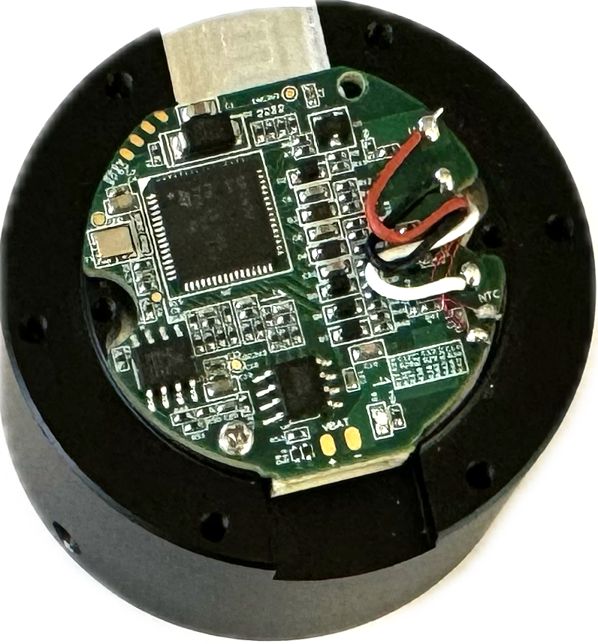
Motor Control
Gearbox
Motor
Motor Controller
Notes:
The motor is technically just the part of the bottom.

Slide 19
To set the polarity of the electromagnet we change the direction of current running through the magnet.
N
S
N
S
+
-

Slide 20
To set the polarity of the electromagnet we change the direction of current running through the magnet.
N
S
S
N
-
+

Slide 21
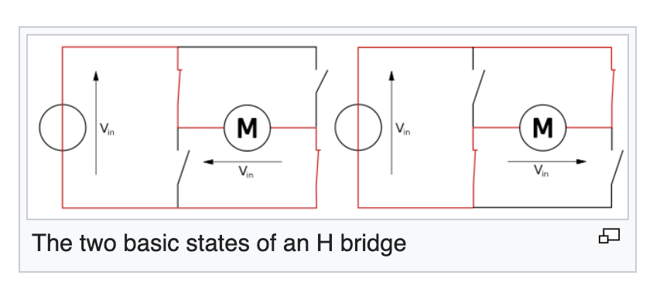
H Bridge
Notes:
An H Bridge provides a method for doing this using four transistors. So we have a way to make the motor work, we would just need to connect each coil of wire to an H Bridge and we could get going. This would results in a large count of transistors (4* total_electro_magnets). We can do better. The primary drawback to this approach is that transistors are actually quite expensive. Especially transistors that can handle large current loads.

Slide 22
H Bridge
Notes:
An H Bridge provides a method for doing this using four transistors. So we have a way to make the motor work, we would just need to connect each coil of wire to an H Bridge and we could get going. This would results in a large count of transistors (4* total_electro_magnets). We can do better. The primary drawback to this approach is that transistors are actually quite expensive. Especially transistors that can handle large current loads.

Slide 23
Motor Controller Questions:
Our motor has 24 electromagnets
If each electromagnet was controlled by its own H Bridge, how many total transistors would be required?

Slide 24
Grouping magnets that should be in the same state
N
S
Notes:
Buy grouping the magnets together we could control all the magnets in a group at the same time. This is substantial and gets us down to only needing three H Bridges total! One for reach group of magnets.

Slide 25
One more constraint: If one magnet is set to north, we can commit that the magnet to it’s immediate left or right must be south. And the other magnet should be off.
N
S
Notes:
We aren’t done yet! There is one more clever trick. If we commit to this added requirement, which turns out to be reasonable, we can also reduce the total wiring, by passing current through longer loops.

Slide 26
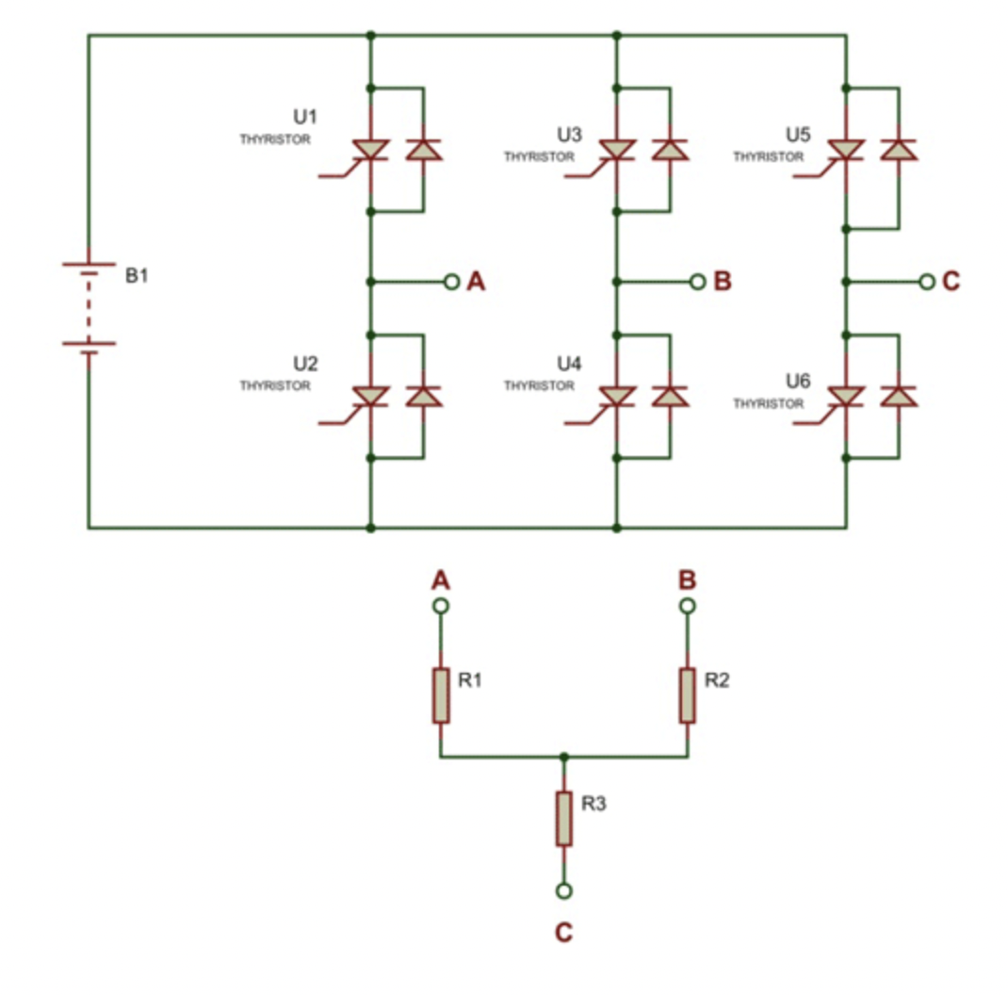
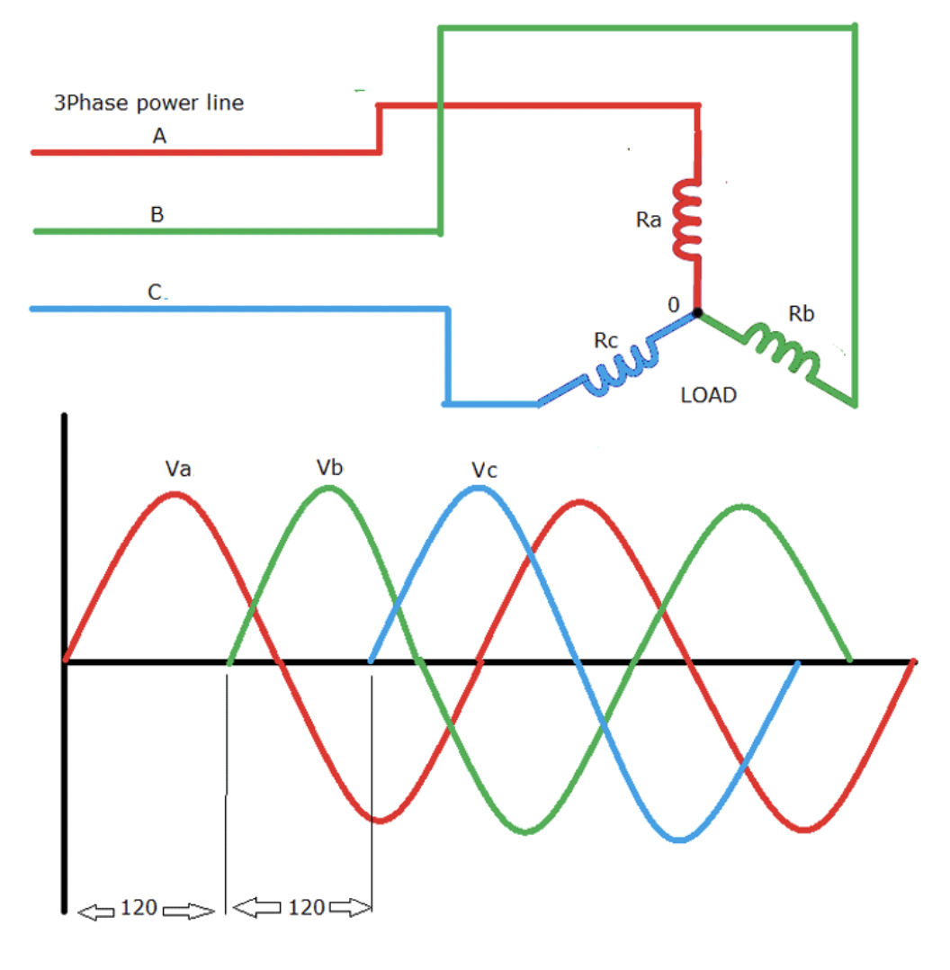
Three Phase Motor
Image Credit: https://circuitdigest.com/tutorial/three-phase-inverter-circuit-diagram-120-degree-and-180-degree-conduction-mode
Notes:
Three phase motors
In order to keep a constant pull on the outer ring the magnets will need to adjust their polarity as the magnets in the outer ring move. If we look at any individual electromagnet it will need to adjust its polarity from being oriented north to south as the outer rotor turns. As a reminder, we can adjust the strength of the magnetic field by passing less current through the wire, but if we want the field to reverse orientation we will need pass current through the coil in the opposite direction.
This can be achieved using transistors where we close and open circuits that let energy flow through one direction v the other.
In theory we could have a separate set of transistors for every single electromagnet, but this gets expensive in practice so ideally we could group them together somehow. To do this we can leverage the idea that there is a periodicity in how the magnets are polarized. Specifically they tend to be offset from each other. So when one magnet is north the adjacent magnet is going to be either South or off. In this way we can group the magnets into three groups. In this case each group would require four transistors to handle be able to fully reverse the flow of power, which would be a total of 12 transistors. There turns out to be a clever way to do this with only six transistors.

Slide 27
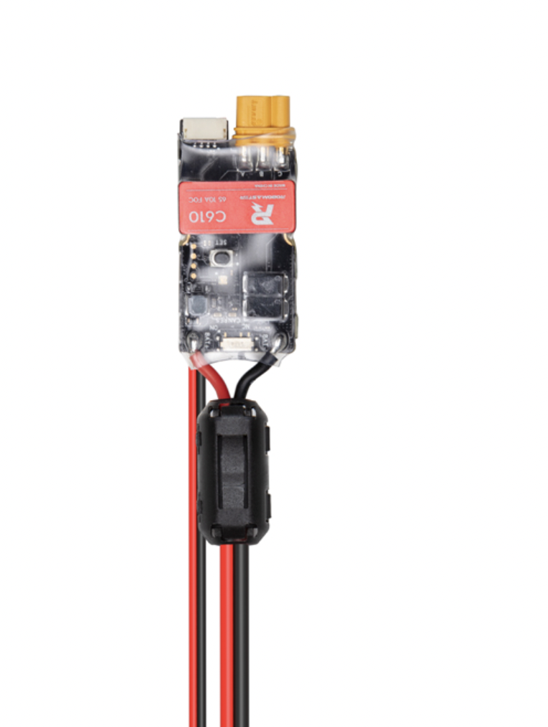
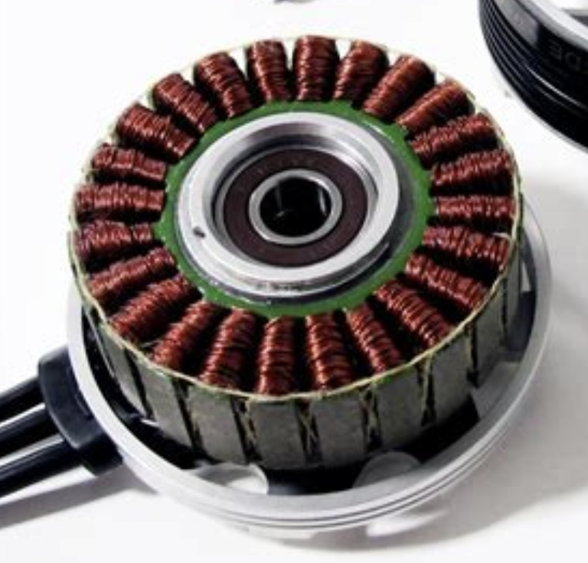
Three Phase Motor
Image Credit: https://circuitdigest.com/tutorial/three-phase-inverter-circuit-diagram-120-degree-and-180-degree-conduction-mode
Notes:
Three phase motors
In order to keep a constant pull on the outer ring the magnets will need to adjust their polarity as the magnets in the outer ring move. If we look at any individual electromagnet it will need to adjust its polarity from being oriented north to south as the outer rotor turns. As a reminder, we can adjust the strength of the magnetic field by passing less current through the wire, but if we want the field to reverse orientation we will need pass current through the coil in the opposite direction.
This can be achieved using transistors where we close and open circuits that let energy flow through one direction v the other.
In theory we could have a separate set of transistors for every single electromagnet, but this gets expensive in practice so ideally we could group them together somehow. To do this we can leverage the idea that there is a periodicity in how the magnets are polarized. Specifically they tend to be offset from each other. So when one magnet is north the adjacent magnet is going to be either South or off. In this way we can group the magnets into three groups. In this case each group would require four transistors to handle be able to fully reverse the flow of power, which would be a total of 12 transistors. There turns out to be a clever way to do this with only six transistors.

Slide 28
Motor Controller Question:
If we assume that the motor controller will optimize the correct polarity of the magnets, what variables can we change to command a stronger or weaker turning force?

Slide 29
Motor Controller Question:
If we assume that the motor controller will optimize the correct polarity of the magnets, what variables can we change to command a stronger or weaker turning force?
Answer: We can modulate the total current through the magnet.

Slide 30
Motor Controller Takeaways:
The motor controller will compute the optimal polarities based on the orientation of the magnets and the desired direction of travel.
For a given polarity the electromagnets will pull proportionate to the current. When you are attempting to control the motor, the input you will provide is the desired current to the motor.

Slide 31
Additional Motor Controller Takeaways:
Motors have three wires because this is a particularly efficient option in terms of total wiring and total transistors. At any time current will be flowing through only two wires, but as the magnets move current will switch between wires and will switch the direction of flow across those wires

Slide 32
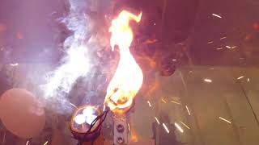
Bonus Topic: Overheating
Notes:
Bonus Job: Stop us from accidentally passing so much current through the wires they heat up cause things to melt. You are unlikely to hit this but there are some cases where you will hear a rather aggressive beeping and see a red light turn on. That is the motor controller being concerned we ae passing too much current.

Slide 33
Extra: Hall Effect
I mentioned that the controller is supposed to modulate the polarities based on the position of the magnets, but there is no extra device showing us position. So how do we get that? It turns out the motor controller can actually measure the current flowing through the system. In particular, as the magnets move they actually cause some current to flow.

Slide 34
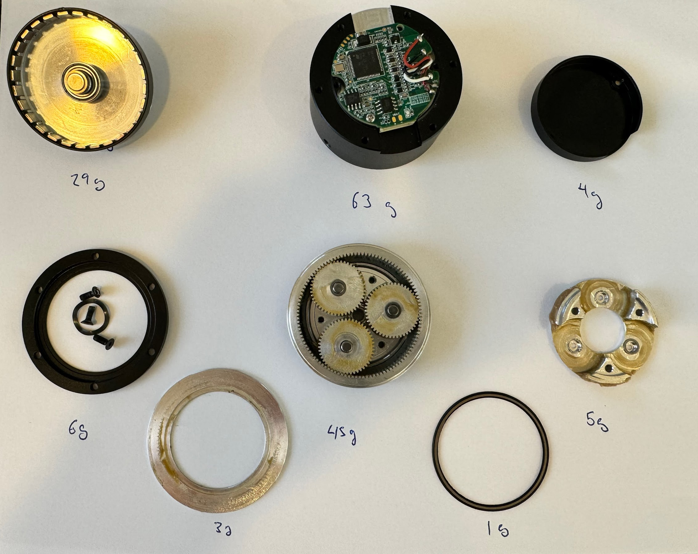

Slide 35
Actuator - Gearbox
Control Algorithms
Gearbox
Motor
Motor Controller
Notes:
The motor is technically just the part of the bottom.

Slide 36
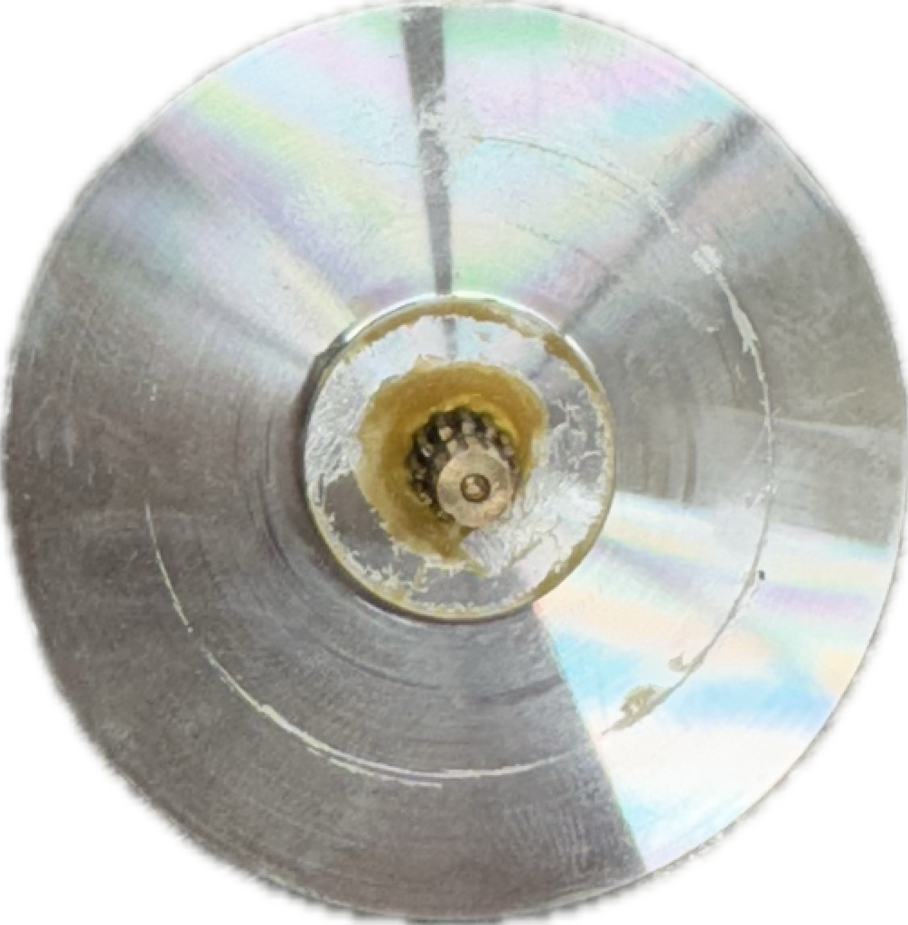
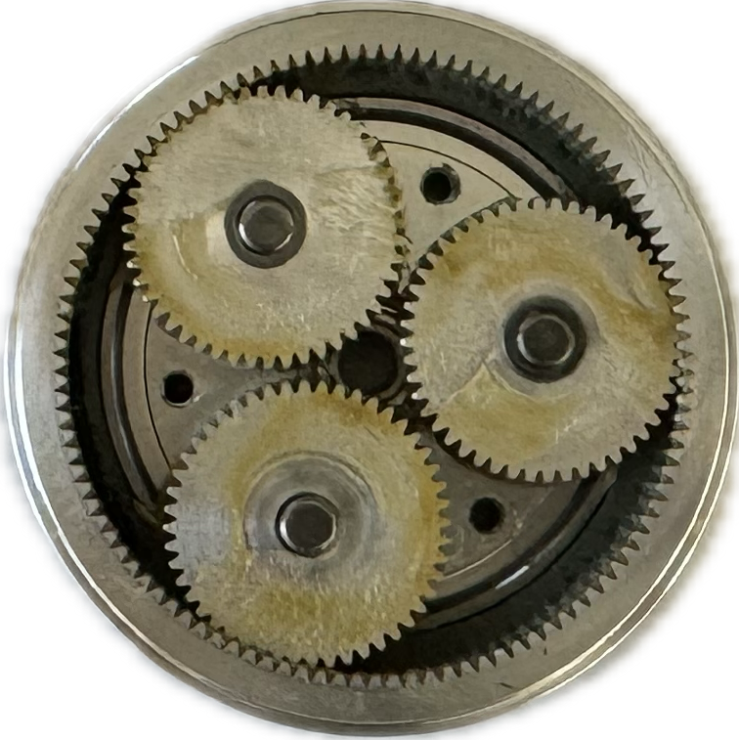
Motor Output:
Max motor torque: 0.3Nm
With Pupper’s leg length this equates to ~0.24kg
Power = force * distance / time
We can increase for by decreasing distance per time
Gears provides a way to trade speed for strength
Gearbox offer 10:1 reduction
https://steadywin.cn/en/pd.jsp?id=9#_jcp=3_3

Slide 37
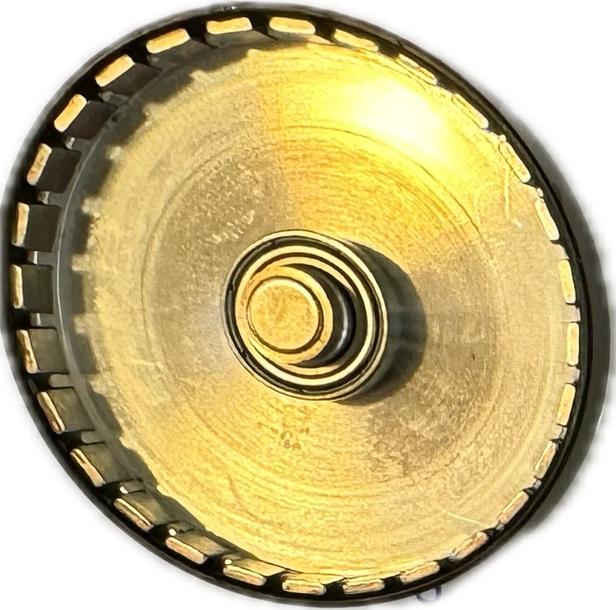
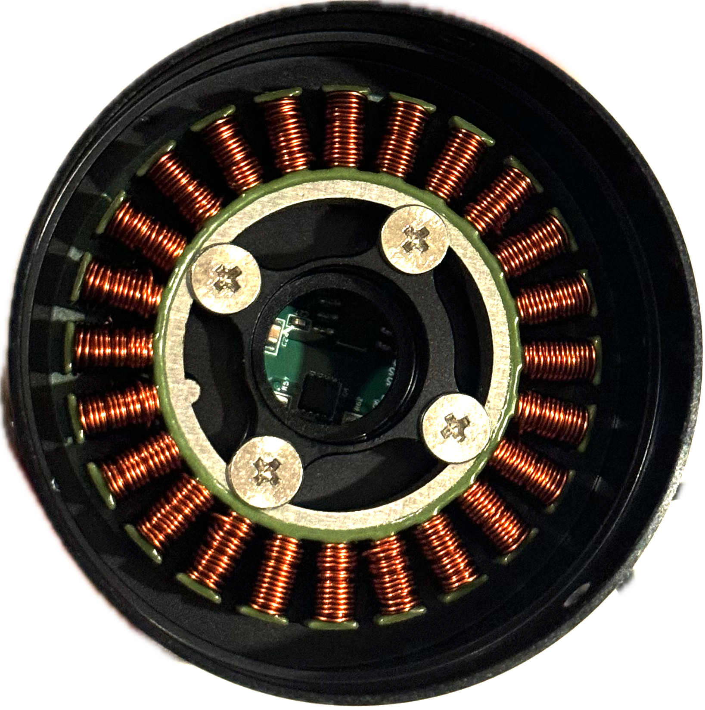
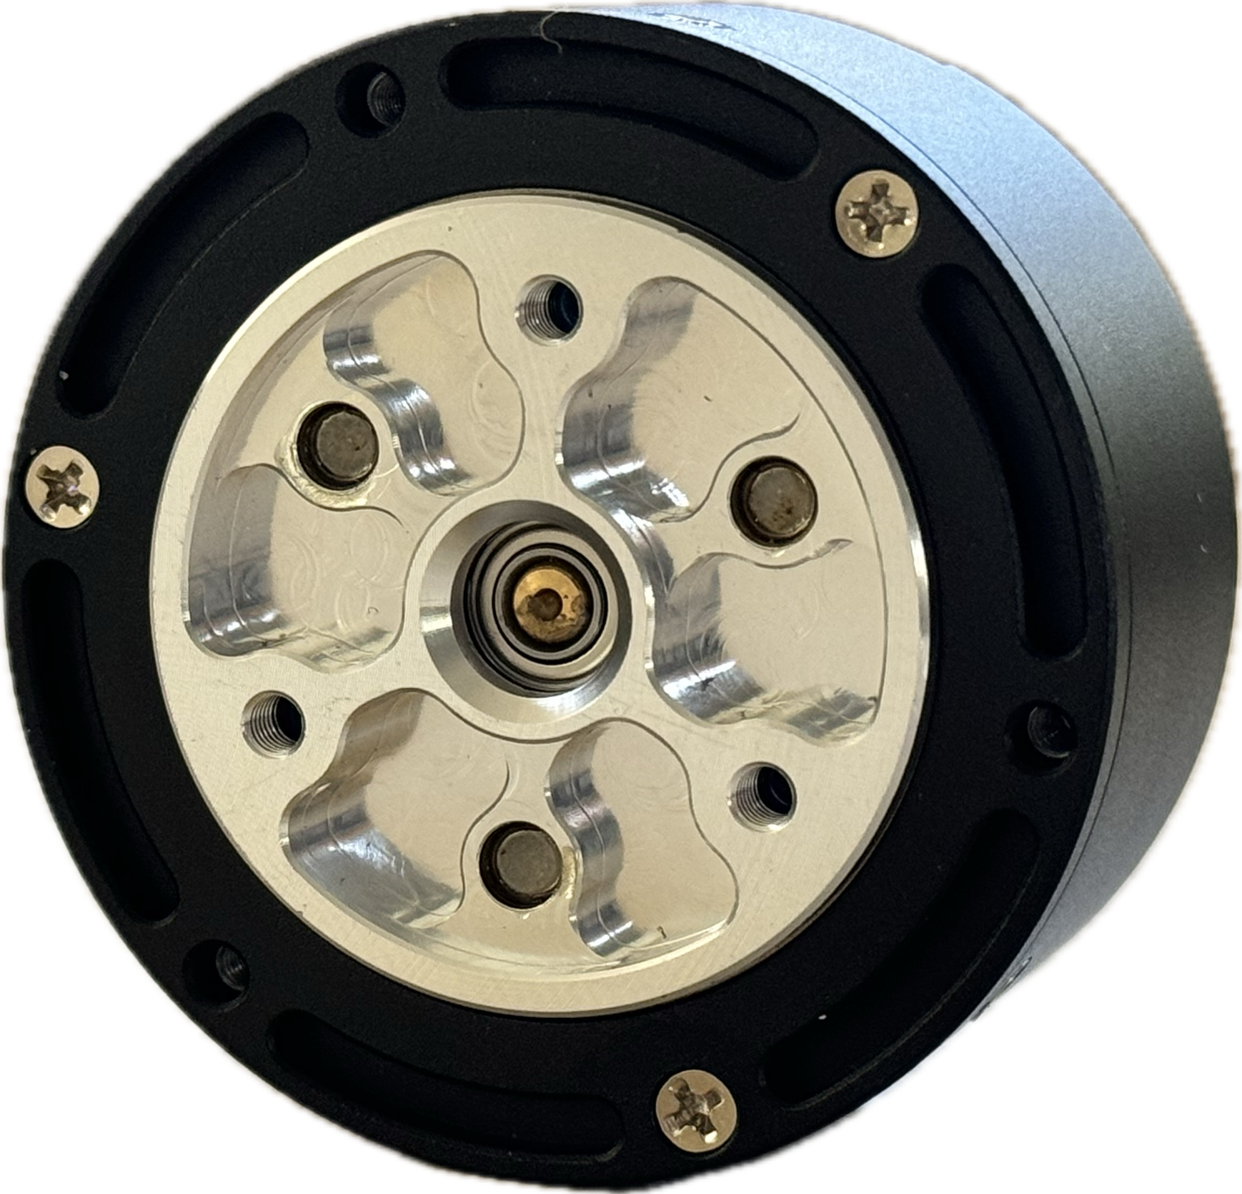
Front
Motor Controller
Permanent Magnets
Planetary Gears
Back
Electromagnets
Sun Gear
Actuator Output

Slide 38
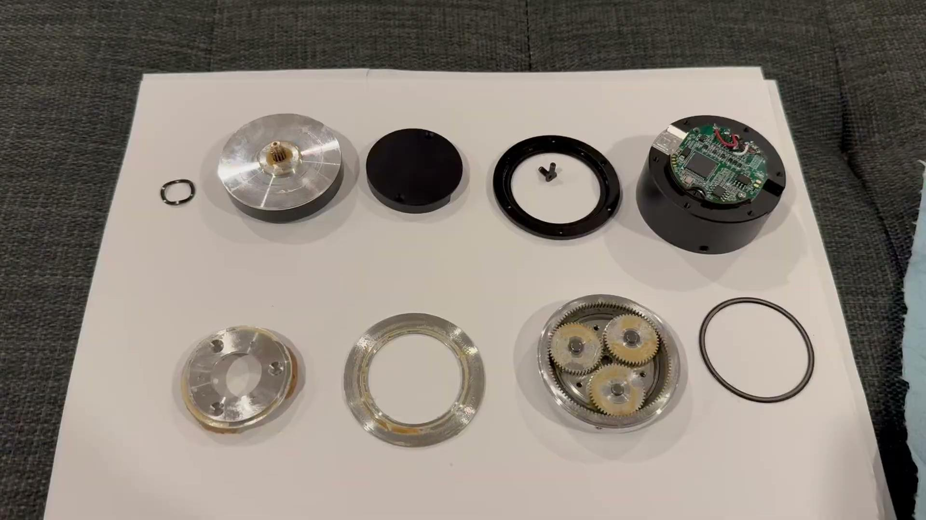
https://steadywin.cn/en/pd.jsp?id=9#_jcp=3_3

Slide 39
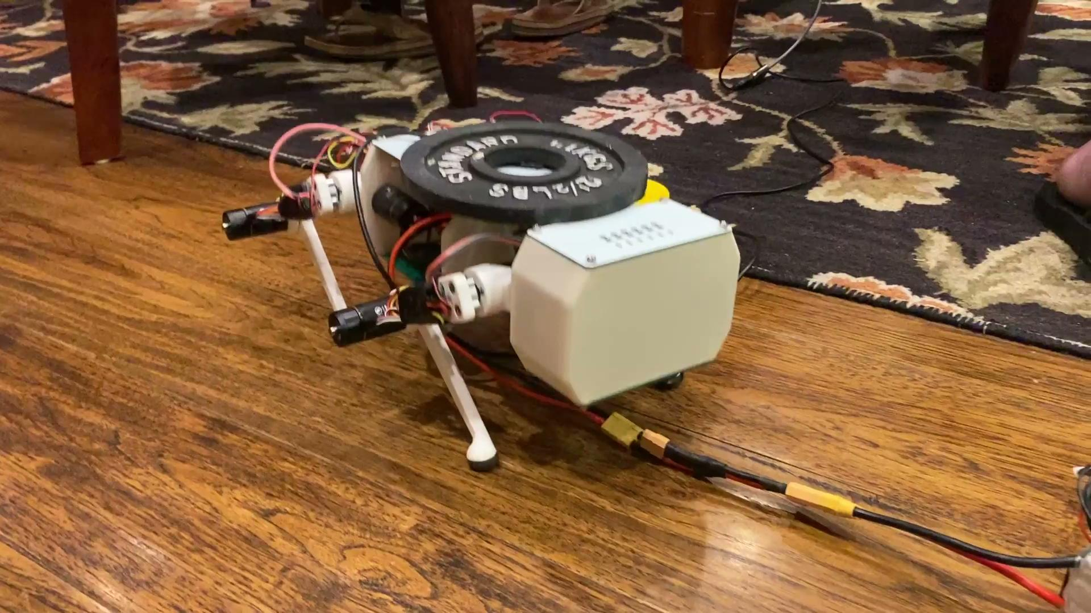
Strength Testing

Slide 40
Actuator Question:
What factors influence the maximum torque an actuator can deliver?

Slide 41
Actuator Question:
What factors influence the maximum torque an actuator can deliver?
Gearbox gear ratio
Strength of magnets
Permanent Magnets <- Neodymium
Electromagnets <- Battery supplied current
Motor diameter

Slide 42
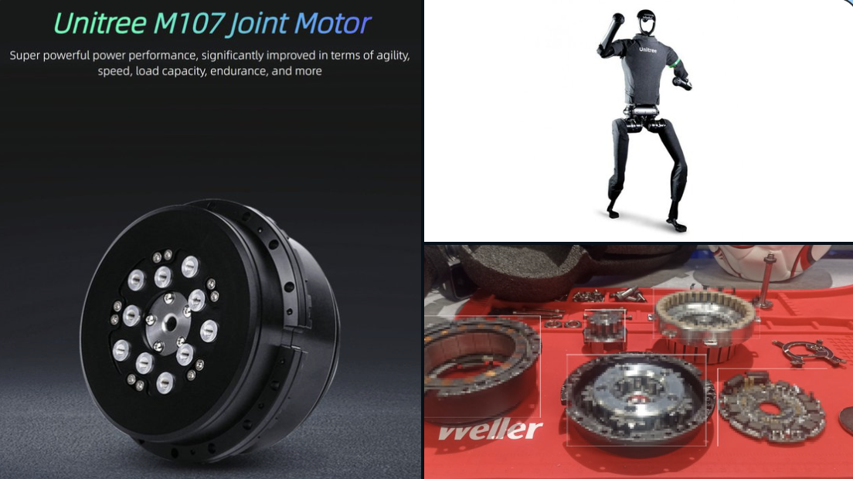
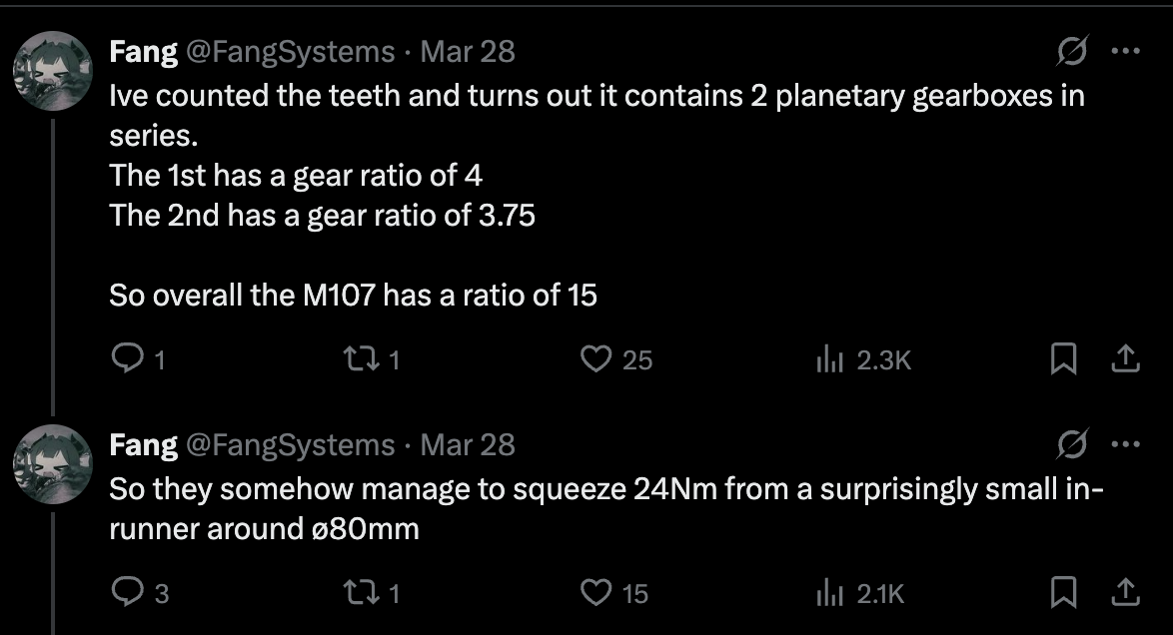
https://x.com/FangSystems/status/1905678306252333182

Slide 43
Battery Capacity:
AA Battery Capacity: 2.85Ah (1.2v)
Dewalt Power Stack Capacity:1.7 Ah (20v)
How many AA batteries are needed to match the energy storage of the lithium ion battery we are using?
Notes:
2.85Ah * 1.2v = 3.42Wh
1.7Ah* 20v =34Wh
34/3.42 = 10 AA Batteries

Slide 44
Battery Capacity:
AA Battery Capacity: 2.85Ah (1.2v)
Dewalt Power Stack Capacity: 1.7Ah (20v)
How many AA batteries are needed to match the energy storage of the lithium ion battery we are using?
Answer: 2.85Ah * 1.2v = 3.42Wh
1.7Ah* 20v =34Wh
34/3.42 = 10 AA Batteries
Notes:
2.85Ah * 1.2v = 3.42Wh
1.7Ah* 20v =34Wh
34/3.42 = 10 AA Batteries

Slide 45
Battery Output:
AA Battery Peak Output: 2A (1.2v)
Dewalt Power Stack Capacity: 30A (20v)
How many AA batteries are needed to match the peak energy output of the lithium ion battery we are using?
Notes:
2A * 1.2v = 2.4 Watts
30A * 20v = 600 Watts
600/2.4 = 250 AA Batteries

Slide 46
Battery Output:
AA Battery Peak Output: 2A (1.2v)
Dewalt Power Stack Capacity: 30A (20v)
How many AA batteries are needed to match the peak energy output of the lithium ion battery we are using?
Answer:
2A * 1.2v = 2.4 Watts
30A * 20v = 600 Watts
600/2.4 = 250 AA Batteries
Notes:
2A * 1.2v = 2.4 Watts
30A * 20v = 600 Watts
600/2.4 = 250 AA Batteries

Slide 47
Controlling Actuator Output
Control Algorithms
Gearbox
Motor
Motor Controller
With the help of the motor controller we can now specify the desired twisting force at each timepoint with a single scalar value expressing the desired current

Slide 48
Controlling output position
Question: How could we select motor currents to orient the wheel 90 degrees to the right?
Target
Notes:
Our goal in this lab will be to orient the motor to a specific position, and to return to the position even if you move it to another one.
From what we just learned about the motor controller we will be doing this with a single input: current
We can command a scalar valued current that can be either positive or negative. When we do this, we will produce a turning force.
So let’s pause here. Say that we have the wheel orientation on the right, where our marker is at the top but our desired position if 90 degrees clockwise. What are some strategies we can use to select the current the get ourselves aligned?

Slide 49
Controlling output position
Bang Bang
Proportional Control
Proportional Derivative Control
Target
Notes:
Our goal in this lab will be to orient the motor to a specific position, and to return to the position even if you move it to another one.
From what we just learned about the motor controller we will be doing this with a single input: current
We can command a scalar valued current that can be either positive or negative. When we do this, we will produce a turning force.
So let’s pause here. Say that we have the wheel orientation on the right, where our marker is at the top but our desired position if 90 degrees clockwise. What are some strategies we can use to select the current the get ourselves aligned?

Slide 50
Controlling output position - Bang Bang
Description: If we are to the left of target set a fixed positive current. If we are to the right, set a fixed negative current.
Target
Notes:
Our goal in this lab will be to orient the motor to a specific position, and to return to the position even if you move it to another one.
From what we just learned about the motor controller we will be doing this with a single input: current
We can command a scalar valued current that can be either positive or negative. When we do this, we will produce a turning force.
So let’s pause here. Say that we have the wheel orientation on the right, where our marker is at the top but our desired position if 90 degrees clockwise. What are some strategies we can use to select the current the get ourselves aligned?

Slide 51
Controlling output position - Bang Bang
Description: If we are to the left of target set a fixed positive current. If we are to the right, set a fixed negative current.
Issue: The controller will add full power even when we are off by a very small amount, making the disk jitter back and forth at the target.
Target
Notes:
Our goal in this lab will be to orient the motor to a specific position, and to return to the position even if you move it to another one.
From what we just learned about the motor controller we will be doing this with a single input: current
We can command a scalar valued current that can be either positive or negative. When we do this, we will produce a turning force.
So let’s pause here. Say that we have the wheel orientation on the right, where our marker is at the top but our desired position if 90 degrees clockwise. What are some strategies we can use to select the current the get ourselves aligned?

Slide 52
Controlling output position - Proportional Control
Description: Add more current as the target is further away.
Target
Notes:
Our goal in this lab will be to orient the motor to a specific position, and to return to the position even if you move it to another one.
From what we just learned about the motor controller we will be doing this with a single input: current
We can command a scalar valued current that can be either positive or negative. When we do this, we will produce a turning force.
So let’s pause here. Say that we have the wheel orientation on the right, where our marker is at the top but our desired position if 90 degrees clockwise. What are some strategies we can use to select the current the get ourselves aligned?

Slide 53
Controlling output position - Proportional Control
Description: Add more current as the target is further away.
Issue: This can still cause overshooting if that target starts far away, since the motor will pick up speed and carry momentum. Fun fact: This is also Hooke’s law: F = kx
Target
Notes:
Our goal in this lab will be to orient the motor to a specific position, and to return to the position even if you move it to another one.
From what we just learned about the motor controller we will be doing this with a single input: current
We can command a scalar valued current that can be either positive or negative. When we do this, we will produce a turning force.
So let’s pause here. Say that we have the wheel orientation on the right, where our marker is at the top but our desired position if 90 degrees clockwise. What are some strategies we can use to select the current the get ourselves aligned?

Slide 54
Controlling output position - PD Control
Description: Proportionate control but add a counteracting force based on speed. E.g. dampening.
Target
Notes:
Our goal in this lab will be to orient the motor to a specific position, and to return to the position even if you move it to another one.
From what we just learned about the motor controller we will be doing this with a single input: current
We can command a scalar valued current that can be either positive or negative. When we do this, we will produce a turning force.
So let’s pause here. Say that we have the wheel orientation on the right, where our marker is at the top but our desired position if 90 degrees clockwise. What are some strategies we can use to select the current the get ourselves aligned?

Slide 55
Controlling output position - PD Control
Description: Proportionate control but add a counteracting force based on speed. E.g. dampening.
Issue: If the load is heavy we will need to wait for enough error to build up to add the counteracting current
Fun Fact: This control method is incredibly common outside robotics.
Heavy
Notes:
Our goal in this lab will be to orient the motor to a specific position, and to return to the position even if you move it to another one.
From what we just learned about the motor controller we will be doing this with a single input: current
We can command a scalar valued current that can be either positive or negative. When we do this, we will produce a turning force.
So let’s pause here. Say that we have the wheel orientation on the right, where our marker is at the top but our desired position if 90 degrees clockwise. What are some strategies we can use to select the current the get ourselves aligned?

Slide 56
Controlling output position - PID Control
Description: Proportionate control with dampening. Also we will add an extra term that looks at the accumulated error and add additional current to counteract it.
Issue: We are still forced to wait for the error to average out for a bit. Next step would be model predictive control. For this class PD control is typically sufficient.
Heavy
Notes:
Our goal in this lab will be to orient the motor to a specific position, and to return to the position even if you move it to another one.
From what we just learned about the motor controller we will be doing this with a single input: current
We can command a scalar valued current that can be either positive or negative. When we do this, we will produce a turning force.
So let’s pause here. Say that we have the wheel orientation on the right, where our marker is at the top but our desired position if 90 degrees clockwise. What are some strategies we can use to select the current the get ourselves aligned?

Slide 57
PID Terminology
P: Add current linearly relative to the position error
Proportional to position
I: Add additional current based on the accumulated position error
Integral of position error
D: Subtract current proportional to the speed
Derivative of position

Slide 58
Questions

